Slide 1
NONRENEWABLE AND RENEWABLE RESOURCES

Slide 2
HMMMM....
Energy resources can be classified a renewable or nonrenewable
What do you think nonrenewable resources are?

Slide 3
What are Nonrenewable resources?
A nonrenewable resource is a natural resource that cannot be re-made or re-grown at a scale comparable to its consumption.

Slide 4
What are some nonrenewable resources?
Fossil Fuels and nuclear power
oil
natural gas
coal

Slide 5
Nonrenewable energy

Slide 6
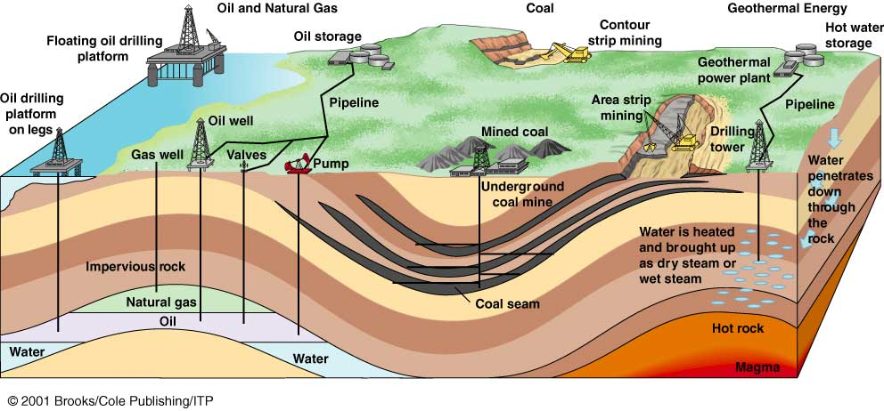
Nonrenewable energy resources removed from the earth’s crust include: oil, natural gas, coal, and uranium.

Slide 7
What are FOSSIL FUELS and how are they different?
Fossil fuel is an energy resource that formed over millions of years from decayed remains of ancient plants and animals .

Slide 8
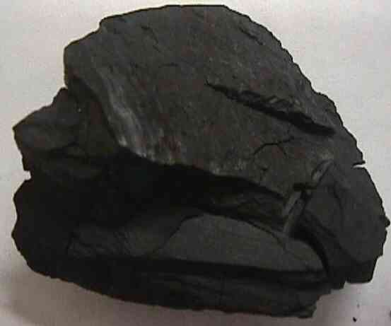
COAL, PETROLEUM, AND GAS
Fossil fuel can not be replenished in a short period of time
Coal- a solid fossil fuel that formed from decayed plants. It is used in many power plants

Slide 9
HOW IS COAL MADE ???

Slide 10
COAL, PETROLEUM, AND GAS
Petroleum – A liquid fossil fuel formed from ancient sea organisms. Also call crude oil. (gasoline and propane)
Natural gas – Is found along with petroleum.
Used in stoves, heaters etc..

Slide 11
HOW ARE OIL AND GAS MADE ???

Slide 12
NUCLEAR ENERGY
Energy is produced by breaking apart atoms (fission uses). Uranium is commonly used
Nuclear energy is a nonrenewable resource because once the uranium is used, it is gone!

Slide 13
What are the advantages and disadvantages of Nonrenewable resources?
Fossil Fuel
Advantages – produces large amounts of energy
Disadvantages – causes pollution and can disturbs animal habitats when drilling
Nuclear Energy
Advantages – does not cause pollution
Disadvantages – the risk of releasing radioactive material in the environment.
Radioactive waste is produced.

Slide 14
HMMMM....
If nonrenewable resources are resources that cannot be re-made at a scale comparable to its consumption, what are renewable resources?

Slide 15
RENEWABLE RESOURCES
Renewable resources are natural resources that can be replenished in a short period of time.
● Solar ● Geothermal
● Wind ● Biomass
● Water

Slide 16
Renewable Energy

Slide 17
SOLAR
Energy from the sun.
Photovoltaic cells also called solar cells are solar panels used to change light energy into electricity . Electricity is stored in solar batteries to be used at night.
Advantage
Clean energy
Disadvantage
Upfront cost
is very high

Slide 18
What is the relationship between solar energy and photovoltaic cells?

Slide 19
What is the relationship between solar energy and photovoltaic cells?
Solar energy is the radiant energy produced by the Sun. It is the result of movement of photons and electrons in electromagnetic radiation.
Photovoltaic cell is a device that can change light energy into electricity it is also called solar cell.
Photovoltaic cell are used in solar energy production

Slide 20
GEOTHERMAL
Energy from Earth’s heat. Must be on a volcanic site
Disadvantage – location limitation

Slide 21
WIND
Energy from the wind.
Advantage – Doesn’t produce pollution or contribute to global warming.
Disadvantage – Very noisy

Slide 22
BIOMASS
Energy from burning organic or living matter (ethanol).
Advantage – Can be added to gasoline in cars to reduce the amount used
Disadvantage – Releases CO2

Slide 23
WATER or HYDROELECTRIC
Energy from the flow of water.
Advantage – Doesn’t produce pollution or contribute to global warming.
Disadvantage – location limitation

Slide 24
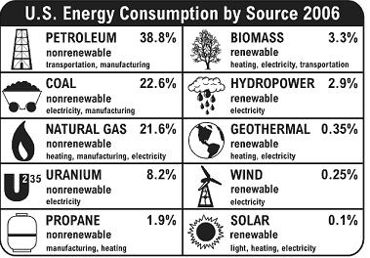

Slide 25
Energy Consevation

Slide 26
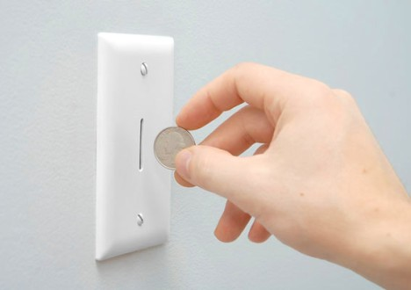
Energy Efficiency Vs Energy Conservation?
What is the difference?
Energy efficiency – the amount of useful energy produced compared to the amount wasted as heat.
Examples of levels of energy efficiency:
human body 20-25% steam turbine: 45%
incandescent light bulb: 5%
internal combustion engine: 20-25%
Energy conservation – making an effort to reduce the amount of energy used, some waste can be avoided – Examples?
Why should we try to increase both?

Slide 27
SUMMARY
What are the differences between nonrenewable and renewable resources?

